Slide 1

Community Reference Group
Thursday 7 December

Slide 2

Agenda
Welcome
Roger Gray
4
Any other business
Julie Wagener
1
5
Close
Roger Gray
General Business Update
Roger Gray
2
Environmental Update
Nigel Ironside
3

Slide 3
2
General Business Update
Roger Gray

Slide 4
General Business Update
Auckland Council
Deloitte Top 200 Awards
Bumper cruise season
Safety update

Slide 5
3
Environmental Update
Nigel Ironside

Slide 6
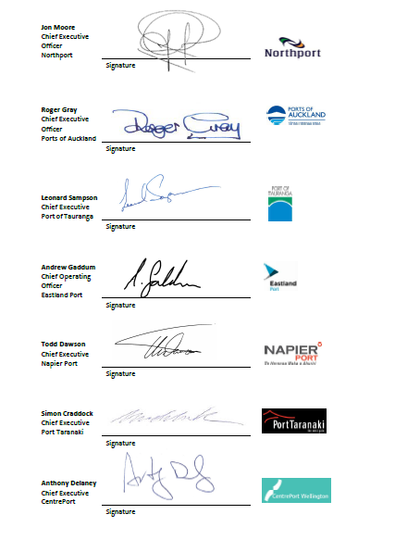
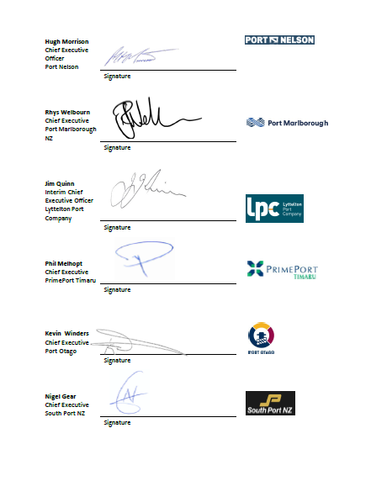
NZ Ports Ship Noise Specification - Recap
From 1 June 2024
New Zealand ports to required shipping lines provide a certified positive ‘NEPTUNES Noise Label Score’ for new container vessels entering an NZ service or confirm that a reactive silencer is fitted to ancillary engines used while at berth from June 1st 2024
Interim Arrangements as Notified to Shipping Lines
All new arrivals to NZ or a vessel of concern to be monitored by NZ ports to establish a ‘Derived Noise Label Score’. Monitoring will be undertaken at a convenient time on an NZ port calls.
Vessel / line to be given 6 months to mitigate negative scores
Ships that do not comply will be denied entry from all NZ ports from June 2024

Slide 7
Noise Specification Implementation - Recap
All relevant vessel information and monitoring reports held in common Ship Noise Register
Compliance to be administered by Marshall Day Limited on behalf of all NZ ports :
  Ports notify Marshall Day of new ships
  Marshall Day to coordinate monitoring, maintain ship register and alert ports of issues and problems
Estimated Noise Label Score | Interim Actions to be Implemented
Strong positive score (greater than +30) | Low likelihood of community complaints
Medium positive score (+10 to +30) | No further action required. Vessel to continue NZ service and will only be revisited if community complaints received in the future.
Low positive score (less than +10) | Vessel to continue service and berthing location to be managed by each port individually. Further monitoring may be required.
Negative score | A negative score is highly likely to generate community concerns. The shipping line / vessel owner will be notified and a timeline of not more than 6 months agreed for mitigation to be implemented. After the agreed timeline the vessel will be re-tested. If the derived noise label score continues to be negative, the vessel will be denied entry to NZ ports.

Slide 8
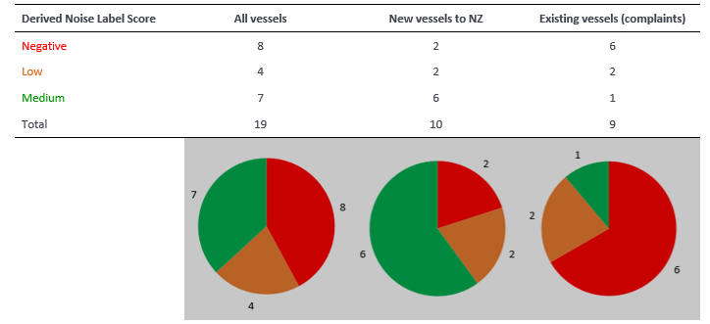
Noise Monitoring Dec. 22 – Dec. 23
Median Score for first time callers was +10
Both new vessels with –ve score (Hong Kong Bridge, GSL Syros) call at Auckland
Several ports have received complaints relating to these vessels
Hong Kong Bridge already withdrawn voluntarily
Further 9 new arrivals on list to be monitored
Median Score for existing callers that received noise complaints was -8
4 noisy vessels withdrawn from NZ service voluntarily
Neither of the 2 remaining vessels call Auckland

Slide 9
Progress Update
Implementation | Initial notification to industry May 2022
 | Monitoring ongoing for all first time callers and existing vessels of concern
 | Port CEOs reviewed progress of implementation in November 2023. Reconfirmed original purpose of scheme to ensure quieter ships service NZ ports in future
 | Monitoring data confirms: majority of vessels calling NZ visit multiple ports and a noisy vessel usually receives numerous public complaint from multiple locations. 2 existing vessels with a -ve score are an issue to only 1 port and that port currently manages noise impacts appropriately to minimise impacts on community Port CEOs agreed to refine implementation of specification for existing vessels with –ve score as follows: Noise problem at multiple ports – lines to be notified they do not meet proposed noise standard and will be refused entry to NZ ports from June 2024 unless appropriate noise mitigation undertaken Noise problem at 1 port (or limited number) - allowed to continue on service after June 2024 provided port in question and their community satisfied that noise impacts are adequately managed Accept other compatible vessel certification schemes e.g. DNV ‘Quiet’ Ship notation
Next Steps | All monitoring Reports to be shared with lines along with indication of compliance post June
 | Communication strategy leading up to ‘go live’ developed. Future correspondence to be made under auspices of Port CEO forum

Slide 10
Any other business?

Slide 11
Thanks
Ngā mihi nui
Do you have any questions?
feedback@poal.co.nz
www.poal.co.nz

